Slide 1
Turtle Games Analysis
LSE Data Analytics Module 3
8th September 2022

Slide 2
Turtle Games is a games manufacturer and retailer and supply customers on a global scale. They manufacturer and sell their own label games whilst also acting as an intermediary for other games manufacturers, selling products which they purchase from competitors.
Through the analysis of available data, Turtle Games stakeholders want to understand the following:
How customers accumulate loyalty points
How groups within the customer base can be used to target specific market segments
How social data can be used to inform marketing campaigns
Impact on sales by product
How reliable the data is
What the relationship is (if any) between geographical locations and global sales.
BRIEF

Slide 3
LOYALTY POINT
ANALYSIS

Slide 4
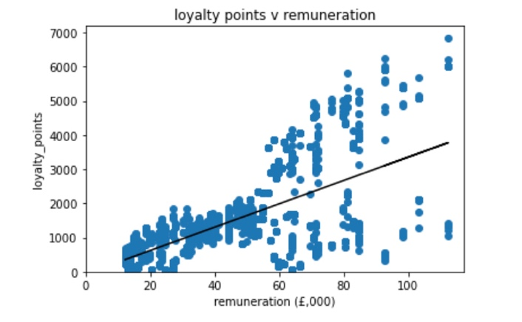
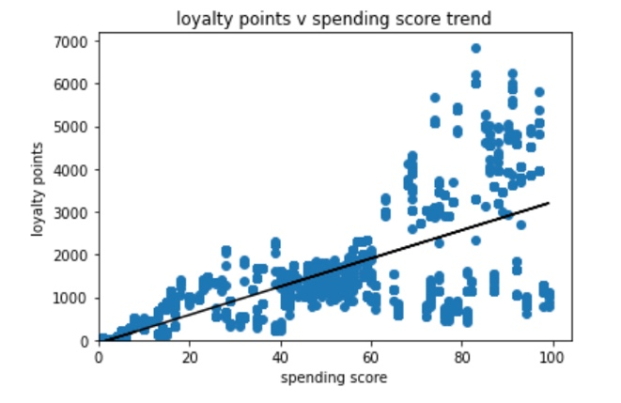
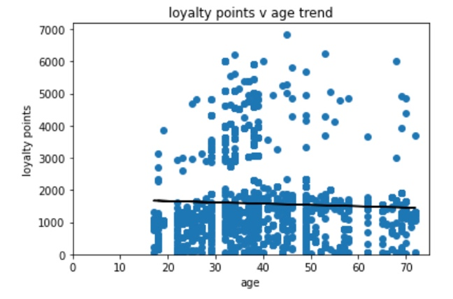
Analysis was performed on the available Turtle Games data, focusing initially on the relationships between Loyalty Points, Spending Score, Remuneration and Age.
The simple linear regression models show us that there is clear linear relationships when it comes to Renumeration and Spending Score but not when it comes to Age.
Linearity
Notes:
Discuss the simple linear model for remuneration and spending score but lack of linearity for age. It would be interesting to see age used as an independent variable combined with one or both of the additional variables to see if it has any additional bearing.
Also note how as the remuneration and spending scores get higher, the data becomes a but more erratic and spread. It would be good to investigate this further to see what causes this variability in data.
Insights here show that we can predict, mostly that the higher the renumeration or spending score the higher the loyalty points will be but that the majority of loyalty point accumulation is clustered between 40 and 60k with a spending score of 4—60. Currently age has no linear relationship with loyalty points

Slide 5
Loyalty Points Insights
For renumeration and spending score, we can predict that the higher the value, the higher the loyalty point accumulation will be.
The majority of Loyalty point accumulation is clustered at
renumeration between £40 and £60,000
Spending score between 40 and 60
Age doesn’t have any linearity with loyalty points and so no real insights can be gained on whether age increases loyalty point accumulation. However, it could be used as a factor in combination with one or both of the other variables being measured. (see continual improvement)
Notes:
Insights here show that we can predict, mostly that the higher the renumeration or spending score the higher the loyalty points will be but that the majority of loyalty point accumulation is clustered between 40 and 60k with a spending score of 4—60. Currently age has no linear relationship with loyalty points

Slide 6
CUSTOMER
CLUSTERING

Slide 7
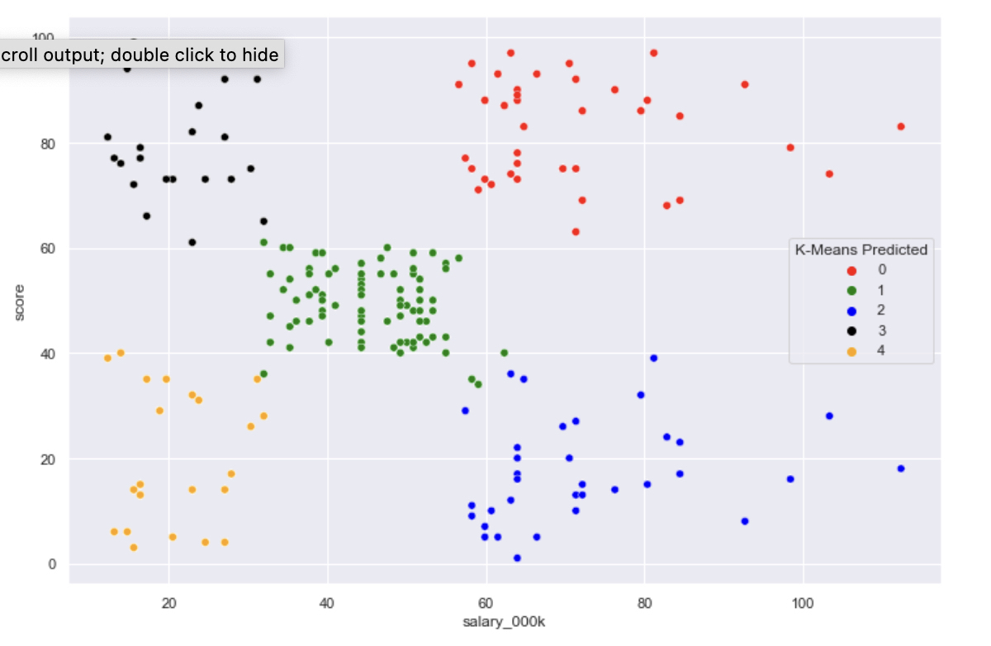
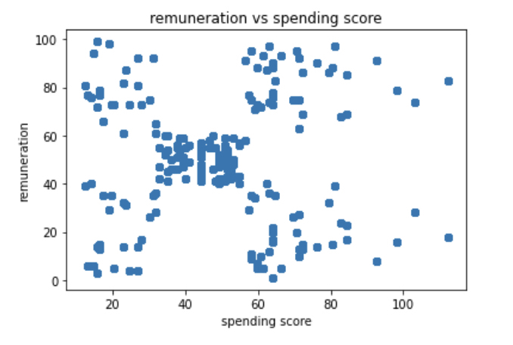
Customer Clustering
In order to support targeted marketing campaigns, we have analysed the customer clusters based on the data that Turtle Games has provided.
Using k-means clustering with Elbow and Silhouette methods, we have identified the optimal number of clusters.
Initial modelling of the data points to 5 clusters and further analysis was completed looking at 4,5 and 6 clusters to determine the optimal

Slide 8
SOCIAL SENTIMENT

Slide 9
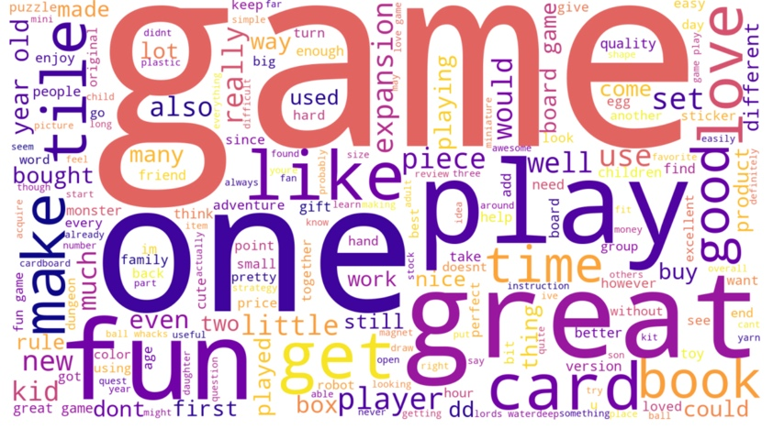
Word Cloud
Taking the list of reviews from the Turtle Games data we were able to derive a word cloud which focuses in on the most frequently used words.
Overwhelmingly positive, with the most frequently used words appearing larger in the word cloud.

Slide 10
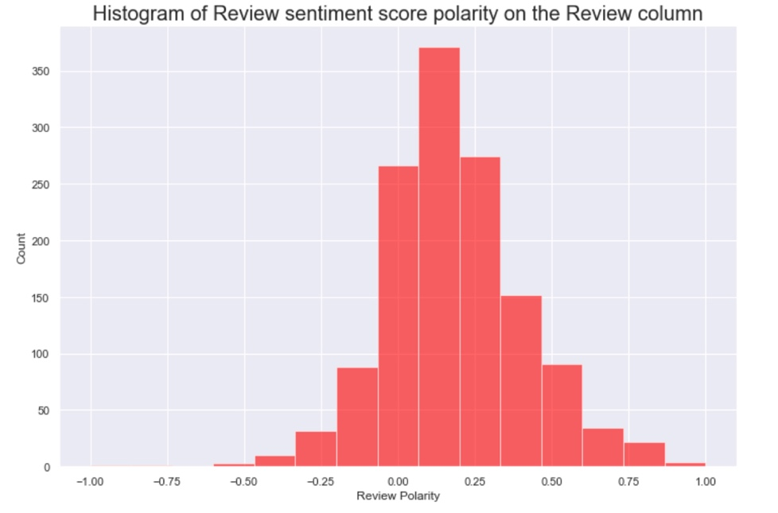
Sentiment
In addition to the word cloud, we have been able to determine the sentiment scores as well as identify the top and bottom 20 reviews for Turtle Games.
As expected from the word cloud, sentiment within the reviews is largely positive with the majority of entries being neutral or positive.

Slide 11
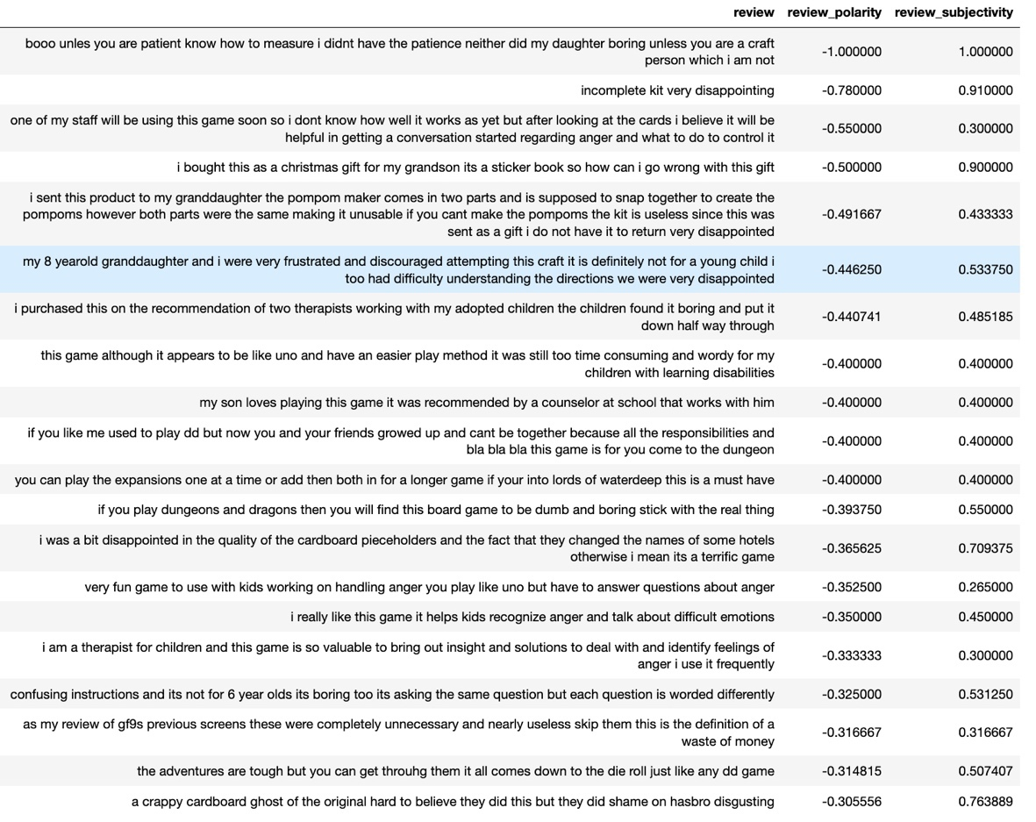
Social Sentiment (2)
The best and worst 20 reviews based on the sentiment scores have been identified and are shown here.
Whilst it is always useful to have positive feedback, the recommendation to Turtle Games is that they should be acting on the negative sentiment to improve business retention and improve business reputation be that through manufacture, customer service or other supply chain improvements.

Slide 12
PRODUCT SALES

Slide 13
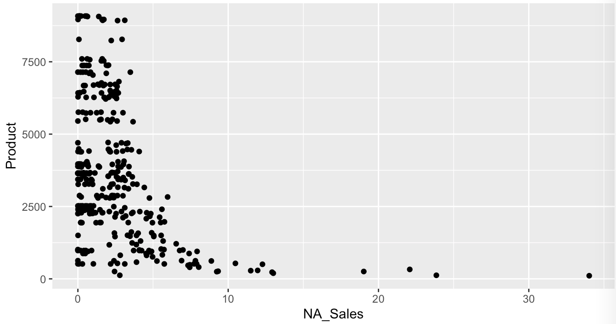
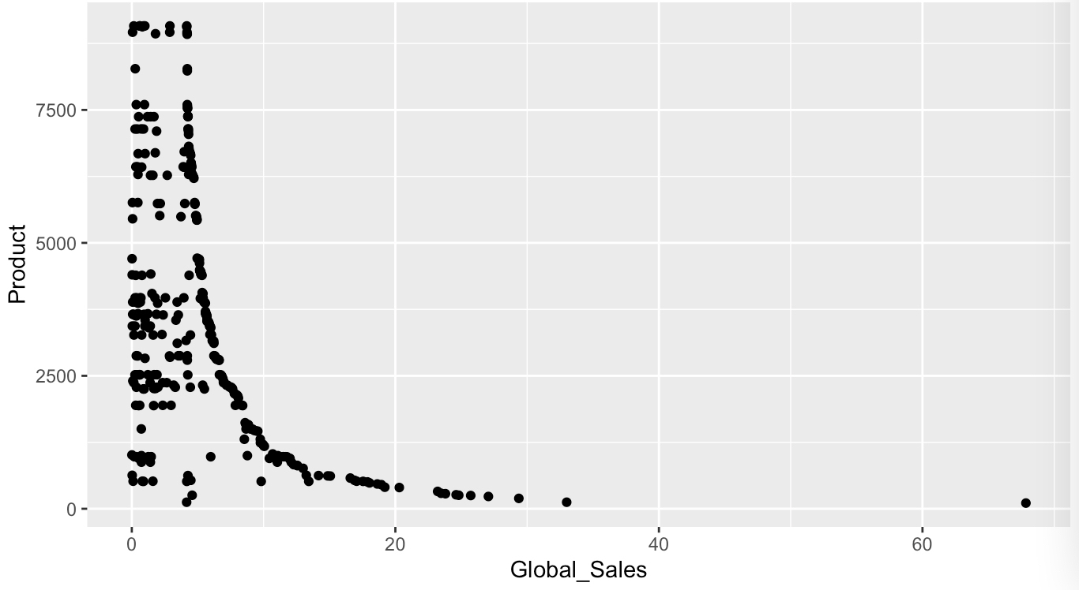

Product Sales
The lower product ID’s have the biggest impact on global sales but interestingly both NA and EU Sales also follow that pattern.
Notes:
Grouped the sales by product ID and plotted them using R and the statistical packages available there ggplot
The initial plot of Products against Global Sales show that the lower, more original products with lower product IDs contribute far more to Global Sales than newer products with higher Product ID’s. This is predicated on the assumption that lower product IDs are the original product ranges of Turtle Games.

Slide 14
Sales Correlation
As well as reviewing Product impact on Global Sales, the correlation between EU and NA Sales to Global Sales was reviewed using single linear and multiple linear regression.
Regression Model | R- Squared
EU Sales vs Global Sales | 77.01%
NA Sales vs Global Sales | 87.4%
EU & NA Sales vs Global Sales | 96.8%

Slide 15
DATA
RELIABILITY

Slide 16
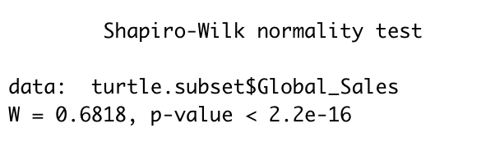
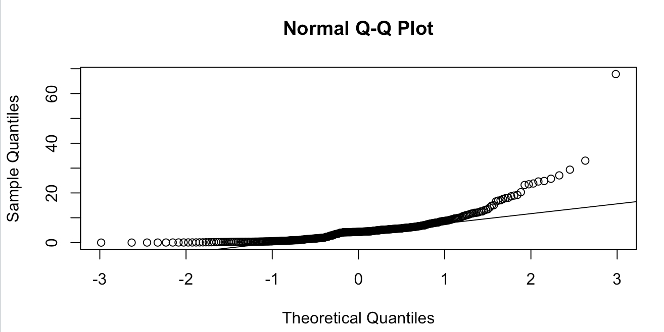
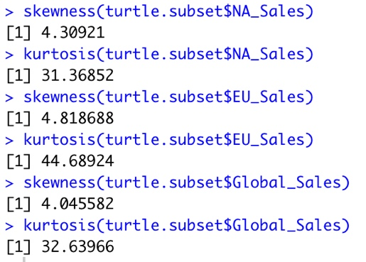
How reliable is the data?
To understand how reliable the data is, several tests have been performed to check normality, skewness and kurtosis.
Notes:
Current form, the model is not reliable.
Normality – how the data is distributed
Shapiro- Wilk test – the p value should be > 0.05 for normal
Skewness – heavily positively skewed which means the mean is greater than the median. It also means that the outliers are to the left (which is where the tail is). This also means that this model is not reliable.
Kurtosis – shows us that the skewed bell is very thin with a high peak

Slide 17
FURTHER INVESTIGATION

Slide 18
Continual Improvement
Further investigation is recommended on the data sets provided by Turtle Games, with focus areas including:
Multiple linear regression to be performed against the loyalty points to see if there is a combination which more accurately predicts the combination that will enhance loyalty point acquisition.
Breakdown of EU and NA states/countries to have a more granular view of where the sales make up is and where to target campaigns
Cleanse the data or get additional data to get a better, more normalised data set.
Run a multiple linear regression of loyalty points, using score, age and remuneration to see if the age has any additional influence over loyalty points.
Identify further negative sentiment to link to specific products or determine ways of improving manufacture or business process.
Look to transform the sales data using logarithmic or alternative methods to try and bring the normality and skewness back towards zero.

